Slide 1






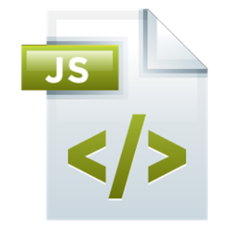
Error Handling Unit Testing with Mocha
Errors and Exceptions, Unit Testing, Tests Cases, Assertions, Hooks
Mocha
SoftUni Team
Technical Trainers
Software University
http://softuni.bg

Slide 2




Table of Contents
Error Handling
Exception Handling
Unit Testing – Concepts
Using Mocha and Chai for JS Unit Testing
Testing with Mocha – Examples

Slide 3
Have a Question?
sli.do #JSCORE

Slide 4





Error Handling in JS

Slide 5
Error Handling – Concepts
In programming, the fundamental principle of error handling says:
In JS, a function failed to do what its name suggests should:
Return a special value (e.g. undefined / false / -1)
Throw an exception / error
A function (method) should either do what its name suggests or indicate a problem.
Any other behavior is incorrect.

Slide 6
Error Handling – Examples
Normal execution → a function does what its name says
Special case → return a special value to indicate "not found"
let str = "Hello, SoftUni";
console.log(str.indexOf("Uni")); // 11
console.log(str.indexOf("")); // 0
let str = "Hello, SoftUni";
console.log(str.indexOf("Sofia")); // -1
console.log(str.indexOf(undefined)); // -1

Slide 7
Error Handling – Exceptions (Errors)
Exception → a function is unable to do its work (fatal error)
let arr = new Array(-1); // Uncaught RangeError
let bigArr = new Array(9999999999); // RangeError
let index = undefined.indexOf("hi"); // TypeError
console.log(asfd); // Uncaught ReferenceError
console.print('hi'); // Uncaught TypeError

Slide 8
Error Handling – Special Values
let sqrt = Math.sqrt(-1); // NaN (special value)
let sub = "hello".substring(2, 1000); // llo
// Soft error → substring still does its job: takes all available chars
let sub = "hello".substring(-100, 100); // hello
// Soft error → substring still does its job: takes all available chars
let inv = new Date("Christmas"); // Invalid Date
let dt = inv.getDate(); // NaN

Slide 9
Unexpected (Not Obvious) Behavior
let d = new Date(2016, 1, 20); // Feb 20 2016 (Jan = 0, Feb = 1)
let dn = new Date(2016, 1, 30); // Mar 01 2016 (next month)
let dp = new Date(2016, -1, 30); // Dec 30 2015 (prev month)
let d1 = new Date(1, 1, 1); // Feb 01 1901
let dMinus1 = new Date(-1, -1, -1); // Nov 29 -2
let pi = new Date(3.14, 3.14, 3.14); // Month / year truncated
// Apr 03 1903 03:21:36 (fractial day turned to hours / minutes)

Slide 10
Problem: Sub-Sum
Write a JS function to sum a range of elements from array
This is a sample solution:
subsum([10, 20, 30, 40, 50, 60], 3, 4)
90
function subsum(arr, startIndex, endIndex) {
let sum = 0;
for (let i = startIndex; i <= endIndex; i++)
sum += arr[i];
return sum;
}

Slide 11
Problem: Sub-Sum – Error Handling
Think about the special cases:
subsum([10, 20, 30, 40, 50, 60], 3, 300)
150
subsum([1.1, 2.2, 3.3, 4.4, 5.5], -3, 1)
3.3
subsum([10, 'twenty', 30, 40], 0, 2)
NaN
subsum([], 0, 0)
subsum([], 1, 2)
0
subsum('text', 0, 2)
subsum({}, 0, 2)
NaN

Slide 12
Solution: Sub-Sum (with Error Handling)
function subsum(arr, startIndex, endIndex) {
if (!Array.isArray(arr))
return NaN;
if (startIndex < 0)
startIndex = 0;
if (endIndex > arr.length - 1)
endIndex = arr.length - 1;
let sum = 0;
for (let i = startIndex; i <= endIndex; i++)
sum += Number(arr[i]);
return sum;
}
explicit error handling / special case handling
Check your solution here: https://judge.softuni.bg/Contests/344

Slide 13








Exception Handling in JS
Throwing Errors / Catching Errors

Slide 14
Exceptions vs. Special Values
Return a special value for expected behavior
Return a value if no problem / a recoverable problem occurs
Valid input arguments → return valid value or special value
E.g. searching something → return the item found or undefined
Thrown an exception for unexpected behavior
When unrecoverable problem occurs
Invalid input arguments / invalid object state / missing resource
E.g. create a card "-2 hearts" or create array of -5 elements

Slide 15


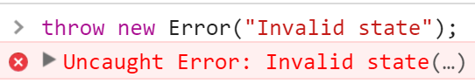
Throwing Errors (Exceptions)
General error
throw new Error("Invalid state");
Value out of range
throw new RangeError("Invalid index");
Expected a different type
throw new TypeError("String expected");
Accessing non-existing object
throw new ReferenceError("Missing age");

Slide 16
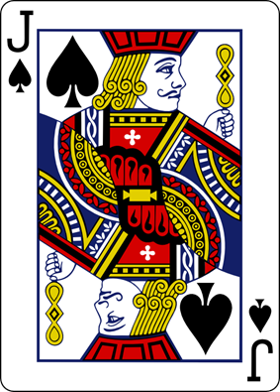
Problem: Playing Cards
A function creates a Card to hold card face + suit
Valid card faces are: 2, 3, 4, 5, 6, 7, 8, 9, 10, J, Q, K, A
Valid card suits are: S (♠), H (♥), D (♦), C (♣)
Throw an error in case of invalid face or suit
console.log('' + makeCard('A', 'S')); // A♠
console.log('' + makeCard('10', 'H')); // 10♥
console.log('' + makeCard('2', 'D')); // 2♦
console.log('' + makeCard('1', 'C')); // Error
console.log('' + makeCard('4', 'W')); // Error

Slide 17
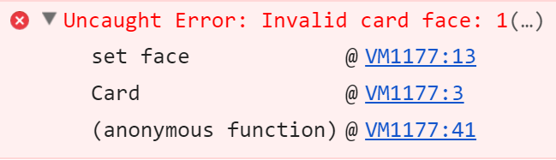
Solution: Playing Cards – Factory Function
function makeCard(face, suit) {
const validFaces = ['2', '3', '4', '5', '6', '7', '8', '9', '10', 'J', 'Q', 'K', 'A'];
const validSuits = ['S', 'H', 'D', 'C'];
if (!validFaces.includes(face))
throw new Error("Invalid card face: " + face);
if (!validSuits.includes(suit))
throw new Error("Invalid card suit: " + suit);
let card = {
face: face,
suit: suit,
toString: () => { … }
};
return card;
}

Slide 18
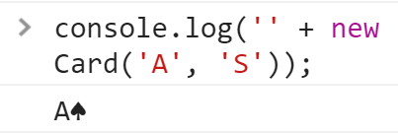
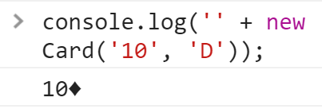
Solution: Playing Cards – toString()
toString() {
let suitToChar = {
'S': "\u2660", // ♠
'H': "\u2665", // ♥
'D': "\u2666", // ♦
'C': "\u2663", // ♣
};
return card.face + suitToChar[card.suit];
}
Check your solution here: https://judge.softuni.bg/Contests/344

Slide 19
List of Cards: Example
Use try-catch block to catch errors (exceptions)
If an error occurs, the control is passed to the catch section
try {
// code that can throw an exception
// some other code → not executed in case of error!
} catch (ex) {
// this code is executed in case of exception
// ex holds the info about the exception
}

Slide 20
Exceptions and Their Properties
try {
throw new RangeError("Invalid range.");
console.log("This will not be executed.");
} catch (ex) {
console.log("---------------");
console.log("Exception object: " + ex);
console.log("Type: " + ex.name);
console.log("Message: " + ex.message);
console.log("Stack: " + ex.stack);
console.log("---------------");
}

Slide 21
Problem: Print Deck of Cards
Write a method to take a deck of cards (each given as string) and print them as sequences of cards (space separated)
Print "Invalid card: [card]" when invalid card is passed as input
printDeckOfCards(['AS', '10D', 'KH', '2C']);
// A♠ 10♦ K♥ 2♣
printDeckOfCards(['5S', '3D', 'QD', '1C']);
// Invalid card: 1C
printDeckOfCards(['3D', 'JC', '2S', '10H', '5X']);
// Invalid card: 5X

Slide 22
Solution: Print Deck of Cards
function printDeckOfCards(cards) {
let deck = [];
for (let cardStr of cards) {
let face = cardStr.substring(0, cardStr.length-1);
let suit = cardStr.substr(cardStr.length-1, 1);
try {
deck.push(makeCard(face, suit));
}
catch (err) {
console.log("Invalid card: " + cardStr);
return;
}
}
console.log(deck.join(' '));
}
Insert the factory
function here
This can throw an error (when the card is invalid)
Check your solution here: https://judge.softuni.bg/Contests/344

Slide 23




What is Unit Testing?

Slide 24
Unit Testing – Definition
A unit test is a piece of code, written by a developer that checks whether a piece of functionality (e.g. function or method), is working as expected.
Source code
Test code (unit tests)
function sortNums(arr) {
arr.sort(
(a,b) => a-b
);
}
let nums = [2, 15, -2, 4];
sortNums(nums);
if (JSON.stringify(nums)
!= "[-2,2,4,15]")
console.error("test failed!");

Slide 25



Unit Tests – Structure
The AAA Pattern: Arrange, Act, Assert
// Arrange all necessary preconditions and inputs
let nums = [2, 15, -2, 4];
// Act on the object or method under test
sortNums(nums);
// Assert that the obtained results are what we expect
if (JSON.stringify(nums) != "[-2,2,4,15]")
console.error("test failed!");

Slide 26


Unit Test – Sum Numbers – Example
function sum(arr) {
let sum = 0;
for (num of arr)
sum += Number(num);
return sum;
}
function testSum() {
if (sum([1, 2]) != 3) throw new Error("1+2 != 3");
if (sum([-2]) != -2) throw Error("-2 != -2");
if (sum([]) != 0) throw new Error("0 != 0");
}

Slide 27
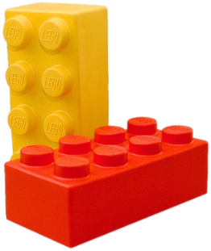

Unit Testing Framework
Unit testing frameworks make writing unit tests simple
Provides test cases, assertions, hooks, test runners, etc.
JUnit, NUnit, Visual Studio Team Test (VSTT), PHPUnit
JS unit testing: Mocha, QUnit, Unit.js, Jasmine, …
Assertion frameworks (perform checks)
Chai, Assert.js, Should.js
Mocking frameworks (mocks and stubs)
Sinon, JMock, Mockito, Moq

Slide 28
Mocha and Chai
Unit Testing in JavaScript

Slide 29
Mocha and Chai
Mocha is JS testing framework
Runs in Node.js and in Web browsers
Usually used together with Chai (assertion library)
let expect = require("chai").expect;
describe("sum(arr)", function() {
it("should return 3 for [1, 2]", function() {
expect(sum([1, 2])).to.be.equal(3);
});
});

Slide 30
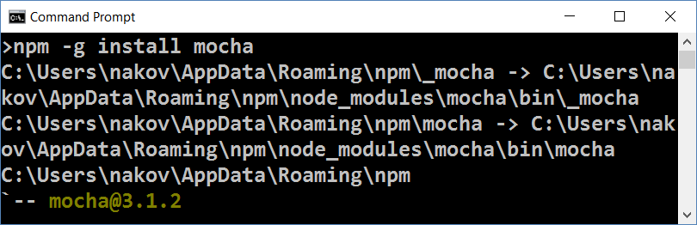
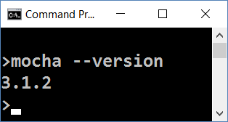
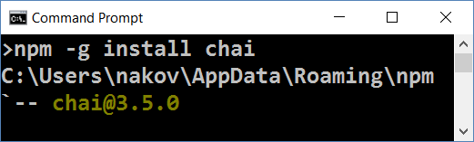
Installing Mocha and Chai
Install Mocha through npm
Check if Mocha is installed
npm -g install mocha
mocha --version
Install Chai through npm
npm -g install chai

Slide 31
Configuring NODE_PATH
By default Node.js does not find its globally-installed modules
You need to set the NODE_PATH environment variable
You may need to restart your IDE after changing NODE_PATH
rem for any future sessions
setx NODE_PATH %AppData%\npm\node_modules
rem for current session
set NODE_PATH=%AppData%\npm\node_modules

Slide 32
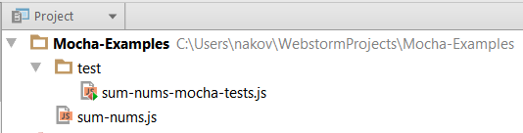
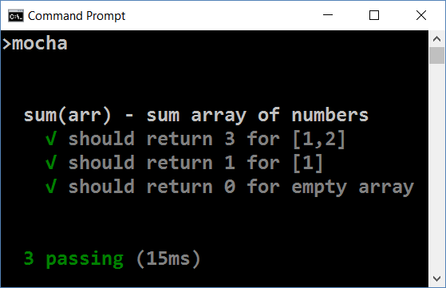
Running Mocha
Create folder "test" in your JS project
Put your test code in test/{test-group-name}.js
Run Mocha from the console
mocha

Slide 33
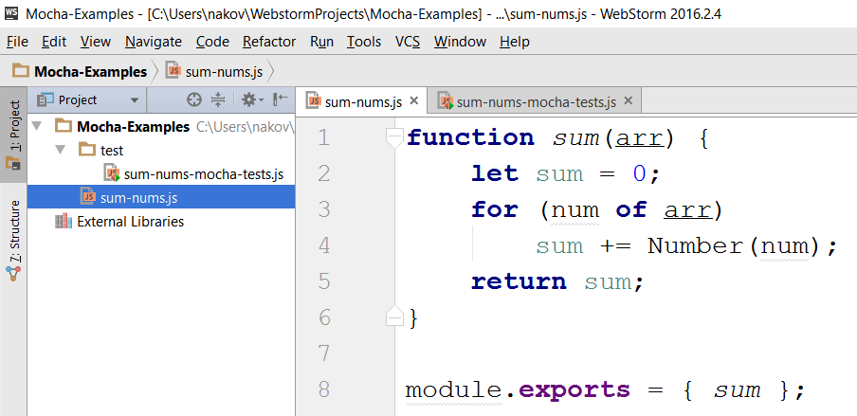
Mocha in Action – Sample Project
Source code to be tested

Slide 34
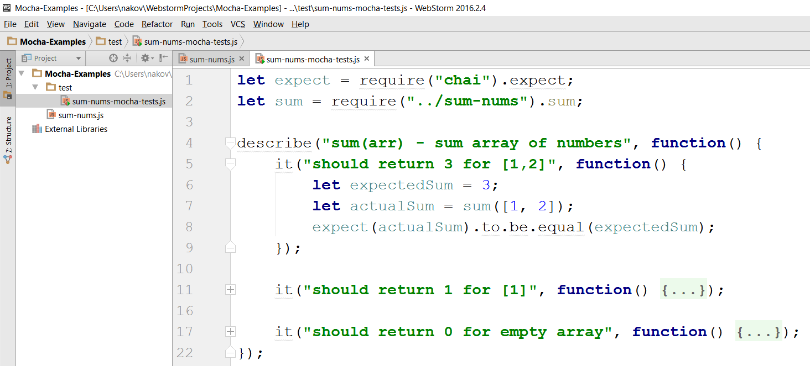
Mocha in Action – Sample Unit Tests
Tests for the sum(arr) function

Slide 35
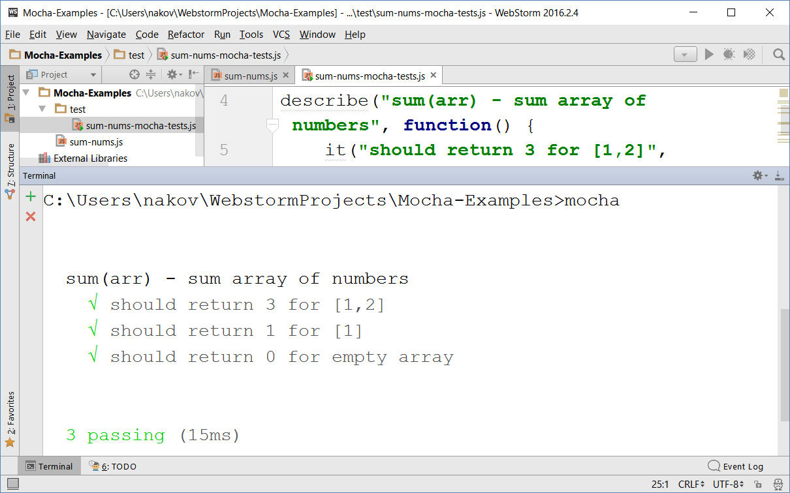
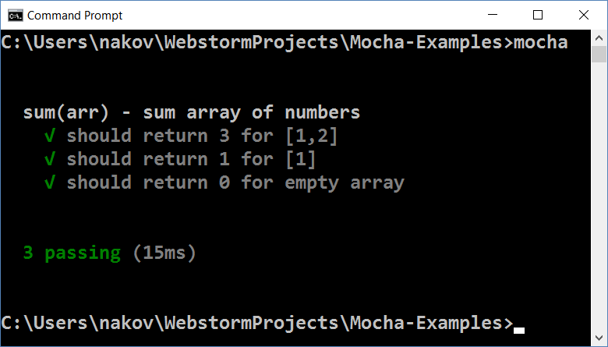
Mocha in Action – Running the Tests

Slide 36
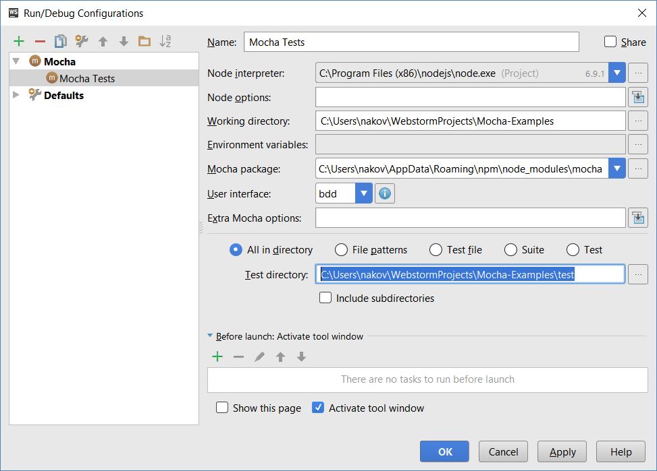
Running Mocha Tests from WebStorm

Slide 37
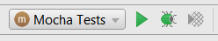
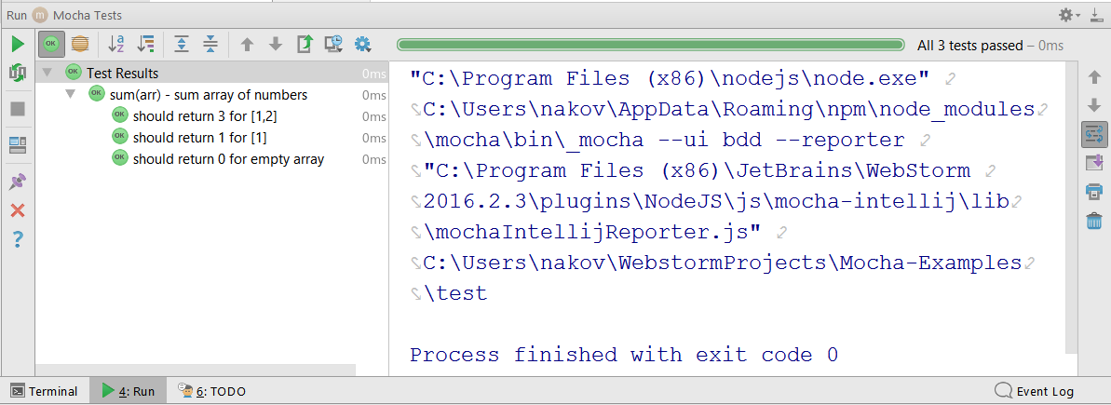
Running Mocha Tests from WebStorm (2)

Slide 38
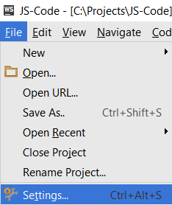
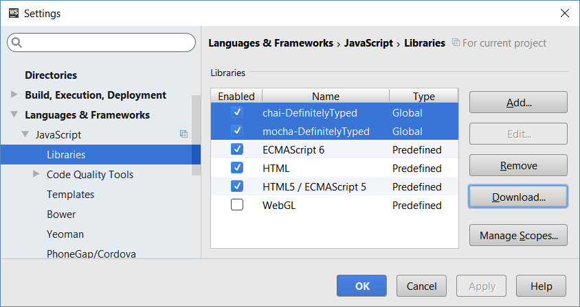
Configuring Libraries in WebStorm
To get the "auto complete" and "syntax checks" working for Mocha and Chai, add them as libraries in WebStorm

Slide 39
Test Groups and Test Cases
describe("Test group #1", function() {
it("should … when …", function() {
expect(actual).to.be.equal(expected);
});
it("should … when …", function() { … });
});
describe("Test group #2", function() {
it("should … when …", function() {
expect(actual).to.be.equal(expected);
});
…
});

Slide 40
Problem – Sum of Numbers
You are given a JS code intended to sum an array of numbers:
Write unit tests to test the sum(arr) function with Mocha
function sum(arr) {
let sum = 0;
for (num of arr)
sum += Number(num);
return sum;
}
Check your solution here: https://judge.softuni.bg/Contests/307

Slide 41

Solution – Sum of Numbers – Test Cases
Design the test cases
sum([1, 2]) → 3
sum([1]) → 1
sum([]) → 0
sum([1.5, 2.5, -1]) → 3
sum("invalid data") → NaN

Slide 42

Solution – Sum of Numbers – Test Code
describe("sum(arr) - sum array of numbers", function() {
it("should return 3 for [1, 2]", function() {
expect(sum([1, 2])).to.be.equal(3);
});
it("should return 1 for [1]", function() {
expect(sum([1])).to.be.equal(1);
});
it("should return 0 for empty array", function() { … });
it("should return 3 for [1.5, 2.5, -1]", function() { … });
it("should return NaN for invalid data", function() { … });
});
Check your solution here: https://judge.softuni.bg/Contests/307

Slide 43
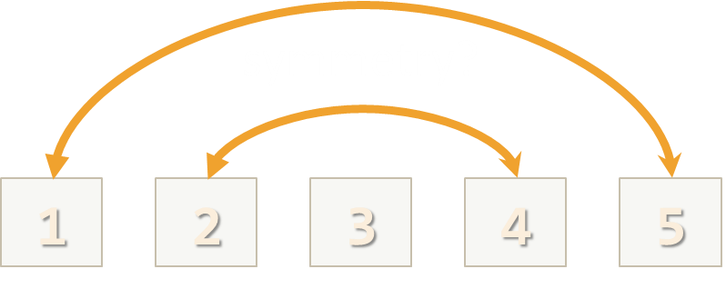
Problem – Check for Symmetry
You are given the following JS code:
Write unit tests to test the above function with Mocha
function isSymmetric(arr) {
if (!Array.isArray(arr))
return false; // Non-arrays are non-symmetric
let reversed = arr.slice(0).reverse(); // Clone + reverse
let equal =
(JSON.stringify(arr) == JSON.stringify(reversed));
return equal;
}
Check your solution here: https://judge.softuni.bg/Contests/307

Slide 44

Solution – Check for Symmetry – Test Cases
Design the test cases
[1,2,3,3,2,1] → true [1,2,3,4,2,1] → false
[-1,2,-1] → true [-1,2,1] → false
[1,2] → false [1] → true
[5,'hi',{a:5},new Date(),{a:5},'hi',5] → true
[5,'hi',{a:5},new Date(),{X:5},'hi',5] → false
1,2,2,1 → false (not an array)

Slide 45
Solution – Check for Symmetry – Test Code
describe("isSymmetric(arr) ", function() {
it("should return true for [1,2,3,3,2,1]", function() {
let symmetric = isSymmetric([1,2,3,3,2,1]);
expect(symmetric).to.be.equal(true);
});
it("should return false for [1,2,3,4,2,1]", function() { … });
it("should return true for [-1,2,-1]", function() { … });
it("should return false for [-1,2,1]", function() { … });
…
});
Check your solution here: https://judge.softuni.bg/Contests/307

Slide 46
Problem – RGB to Hex Color
Using Mocha write unit tests for the following function:
function rgbToHexColor(red, green, blue) {
if (!Number.isInteger(red) || (red < 0) || (red > 255))
return undefined; // Red value is invalid
if (!Number.isInteger(green) || (green < 0) || (green > 255))
return undefined; // Green value is invalid
if (!Number.isInteger(blue) || (blue < 0) || (blue > 255))
return undefined; // Blue value is invalid
return "#" +
("0" + red.toString(16).toUpperCase()).slice(-2) +
("0" + green.toString(16).toUpperCase()).slice(-2) +
("0" + blue.toString(16).toUpperCase()).slice(-2);
}

Slide 47
Solution – RGB to Hex Color – Test Cases
Design the test cases
Start from the typical (normal) cases
(255, 158, 170) → #FF9EAA
(12, 13, 14) → #0C0D0E
(0, 0, 0) → #000000
(255, 255, 255) → #FFFFFF
Then, test the special cases, e.g. invalid input
(-1, 0, 0), (0, -1, 0), (0, -1, 0) → undefined
(256, 0, 0), (0, 256, 0), (0, 0, 256) → undefined
(3.14, 0, 0), (0, 3.14, 0), (0, 0, 3.14) → undefined
("5", [3], {8:9}), (empty input) → undefined

Slide 48
Solution – RGB to Hex Color – Test Code
describe("rgbToHexColor(red, green, blue)", function() {
describe("Nominal cases (valid input)", function() {
it("should return #FF9EAA on (255, 158, 170)", function() {
let hex = rgbToHexColor(255, 158, 170);
expect(hex).to.be.equal('#FF9EAA');
});
…
});
describe("Special cases (invalid input)", function() {
…
});
});
Check your solution here: https://judge.softuni.bg/Contests/307

Slide 49
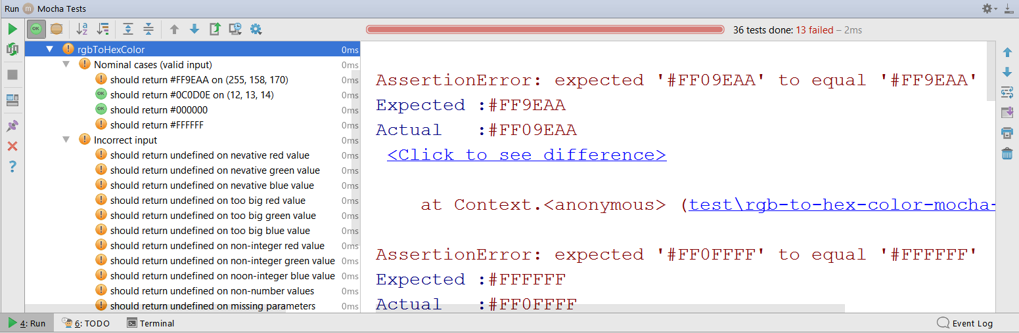
Testing Incorrect Code
function rgbToHexColor(red, green, blue) {
return "#" +
("0" + red.toString(16).toUpperCase()).slice(-2) +
("0" + green.toString(16).toUpperCase().slice(-2)) +
("0" + blue.toString(16).toUpperCase()).slice(-2);
}

Slide 50
Problem – Add / Subtract Module
You are given the following JS code:
Write unit tests to test the above code with Mocha
function createCalculator() {
let value = 0;
return {
add: function(num) { value += Number(num); },
subtract: function(num) { value -= Number(num); },
get: function() { return value; }
}
}
Check your solution here: https://judge.softuni.bg/Contests/307

Slide 51
Solution – Add / Subtract – Test Cases
Design the test cases
create; get → 0
create; add(2); add(3); get → 5
create; subtract(3); subtract(2); get → -5
create; add(5.3); subtract(1.1); get → 4.2
create; add(10); subtract('7'); add('-2'); subtract(-1); get → 2
create; add('hello'); get → NaN
create; subtract('hello'); get → NaN

Slide 52
Solution – Add / Subtract – Test Code
describe("createCalculator()", function() {
let calc;
beforeEach(function() {
calc = createCalculator();
});
it("should return 5 after {add 3; add 2}", function() {
calc.add(3); calc.add(2); let value = calc.get();
expect(value).to.be.equal(5);
});
…
});
Mocha hook: called before each test
Check your solution here: https://judge.softuni.bg/Contests/307

Slide 53

Practice: Unit Testing in JS
Live Exercises in Class (Lab)

Slide 54


Summary
JS functions should do what their name says or indicate a problem
Unit tests are programs that check whether a piece of code works as expected
let expect = require("chai").expect;
describe("sum(arr)", function() {
it("shoud sum 1+2 = 3", function() {
expect(sum([1, 2])).to.be.equal(3);
});
});

Slide 55







Unit Testing with Mocha
https://softuni.bg/courses/

Slide 56
License
This course (slides, examples, demos, videos, homework, etc.) is licensed under the "Creative Commons Attribution-NonCommercial-ShareAlike 4.0 International" license

Slide 57





Free Trainings @ Software University
Software University Foundation – softuni.org
Software University – High-Quality Education, Profession and Job for Software Developers
softuni.bg
Software University @ Facebook
facebook.com/SoftwareUniversity
Software University Forums
forum.softuni.bg

